Slide 1
BEEE102L Basic Electrical and Electronics Engineering
S. Meikandasivam

Slide 2
Books
Text Book
Allan R. Hambley, ‘Electrical Engineering -Principles & Applications’, Pearson Education, First Impression, 6/e, 2013
Reference Books
1. Charles K Alexander, Mathew N O Sadiku, ‘Fundamentals of Electric Circuits, Tata McGraw Hill, 2012.
2. Robert L Boylestad, ‘Introductory Circuit Analysis’, Pearson Education Ltd, 12 t h Edition, 2010
3. W. H. Hayt, J.E. Kemmerly and S. M. Durbin, ‘Engineering Circuit Analysis’, 6/e, Tata McGraw Hill, New Delhi, 2011
4. Del Toro ,Vincent , ‘Electrical Engineering fundamentals’, 2/e PHI Learning , 2013
5. Fitzgerald, Higgabogan, Grabel, ‘Basic Ele ctrical Engineering ’, 5t h edn., McGraw Hill, 2009.

Slide 3
Module 1 DC Circuits
Basic circuit elements and sources; Ohms law; Kirchhoff’s laws; Series and Parallel connection of circuit elements; Star-delta transformation; Mesh current analysis; Node voltage analysis; Theorems: Thevenin's, Maximum power transfer and Superposition theorem

Slide 4
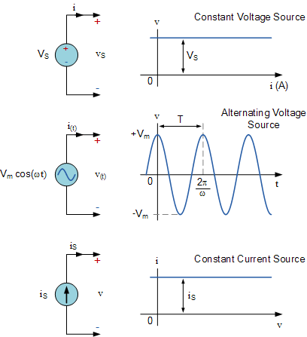
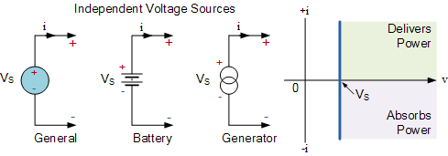
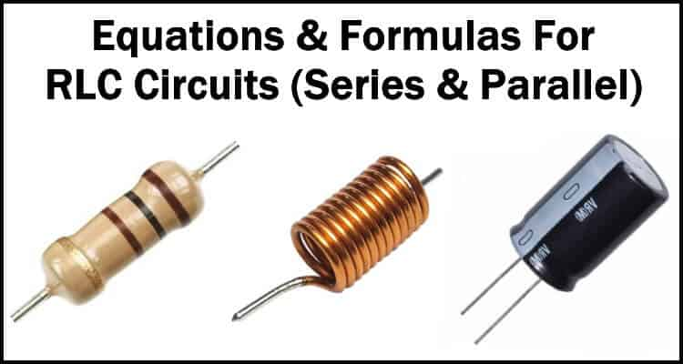
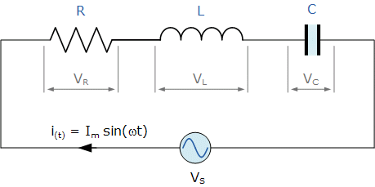
Circuit Elements
Active Elements
Voltage Source (V)
Current Source (I)
Passive Elements
Resistor (R)
Inductor (L)
Capacitor (C)
Examples:
Voltage sources: Battery, Generator
Current Sources: can built using
semiconductor devices, e.g. solar PV cell,
Transistor active region, etc.,

Slide 5
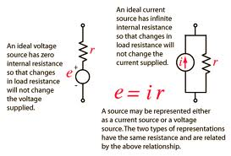
Active Sources
Ideal V/I source
Practical V/I Source
+
-
i
e
https://www.etechnog.com/2021/03/voltage-current-source-example-difference.html

Slide 6
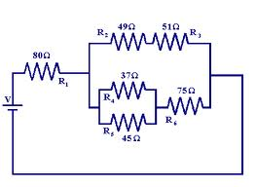
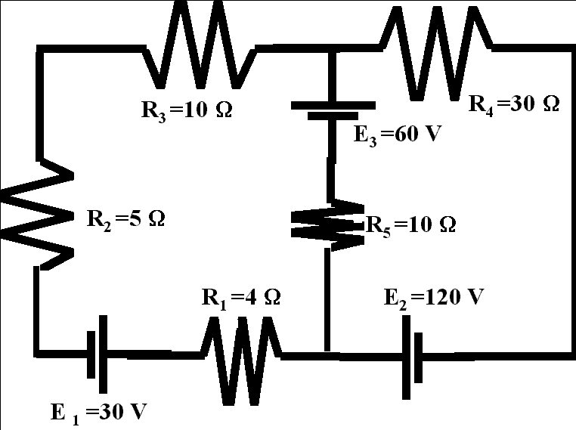
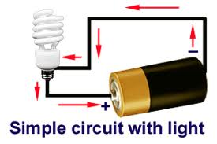
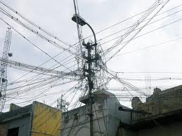
Electric Circuit

Slide 7
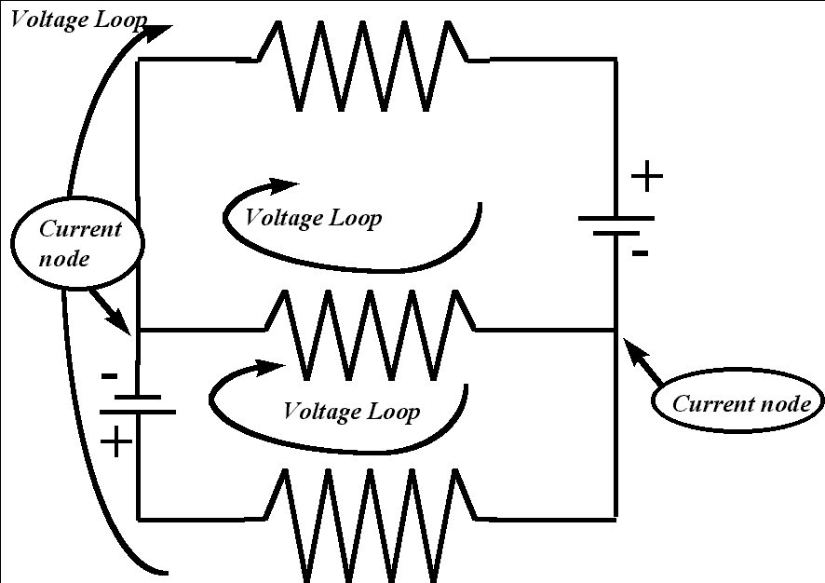
Electric Circuit
A simple Electric Circuit is a closed connection of active and passive elements with wires.
These elements may connect in series/parallel(shunt)/combination of both to form a circuit.
An Electric circuit consist of loops and nodes.
Branch
Loop
Node

Slide 8
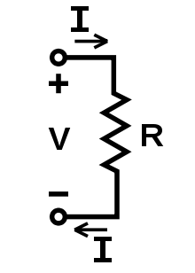
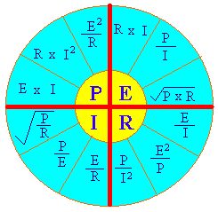

Ohms Law
Ohms law states that the voltage across a resistance is directly proportional to the current flowing through it at constant temperature.

Slide 9
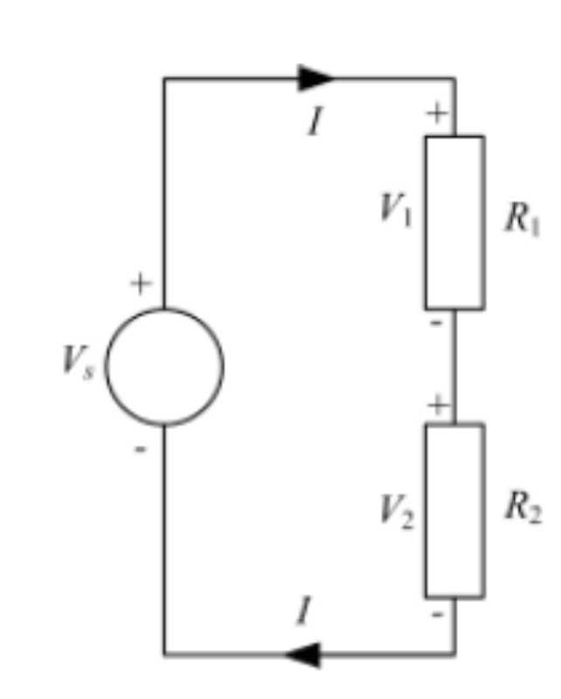
Kirchoff’s Law
Kirchoff’s Voltage Law
The algebraic sum of all the voltages (rises and drops) around a closed loop is equal to zero.
The algebraic sum of all voltage rises/sources is equal to the algebraic sum of all the voltage drops around a closed loop.
V_{S} = V₁ + V₂ = IR₁ + IR₂
V_{S} + IR₁ + IR₂ = 0

Slide 10
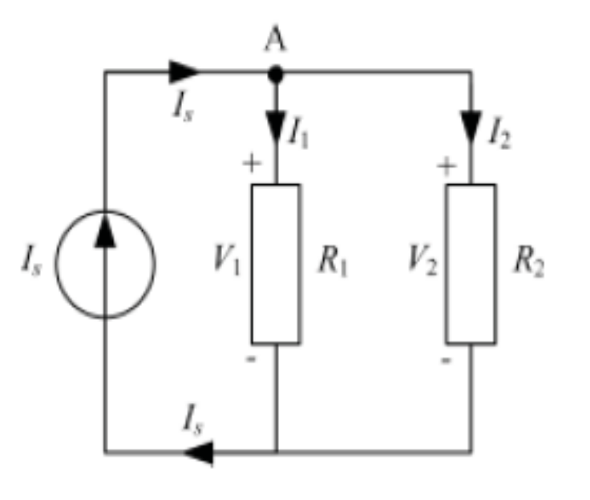
Kirchoff’s Law
Kirchoff’s Current Law
The algebraic sum of all the currents entering or leaving a node in an electric circuit is equal to zero.
The algebraic sum of currents entering is equal to the algebraic sum of currents leaving the node in an electric circuit.
I_{S} = I₁ + I₂ = V/R₁ + V/R₂
I_{S} + V/R₁ + V/R₂ = 0

